Slide 1
FLIP ROBO
CAR PRICE PREDICTOR

Slide 2
PROBLEM STATEMENT
BUILDING A MACHINE LEARNING MODEL TO PREDICT THE USED CAR PRICES USING THE GIVEN INDEPENDENT VARIABLES.

Slide 3
EDA STEPS AND VISUALIZATIONS
Checking various parameters like number of unique values in each column.
No null values present.

Slide 4
DATASETS USED FOR TRAINING PURPOSE
Dataset was obtained from cardekho.com by web scraping using selenium.

Slide 5
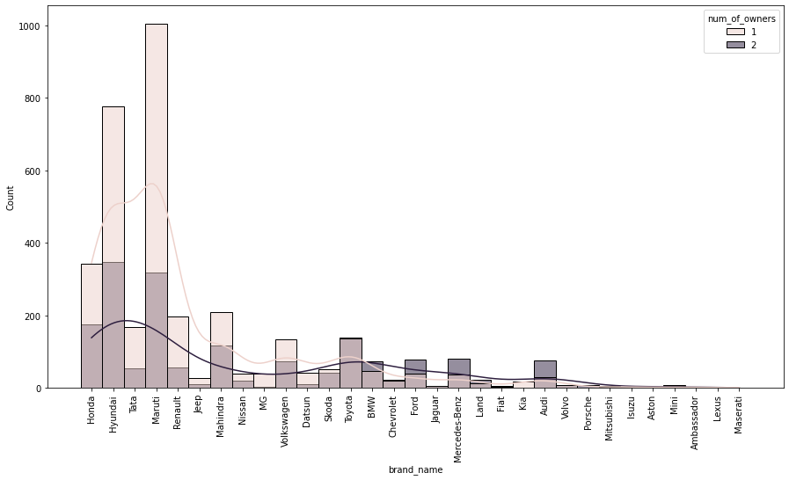
SOME VISUALIZATIONS

Slide 6
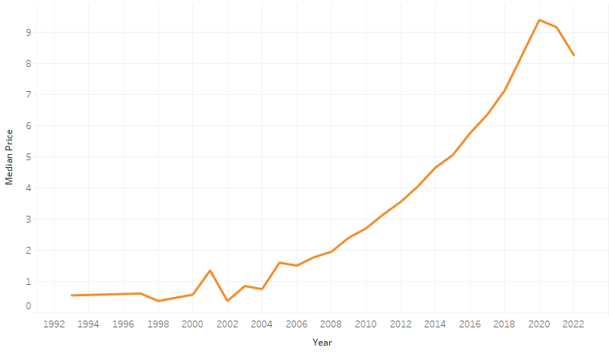

Slide 7
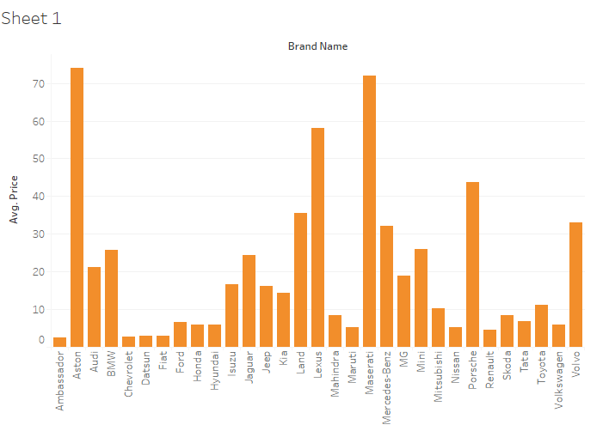

Slide 8
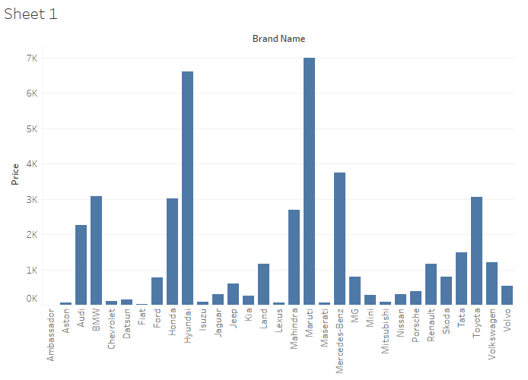

Slide 9
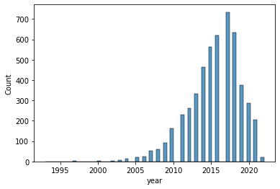
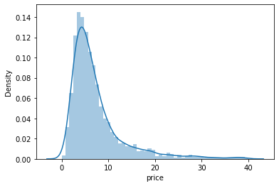
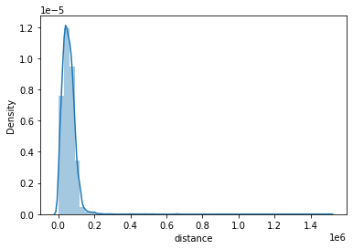
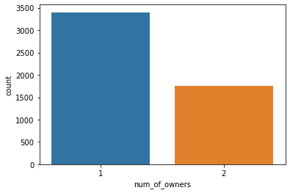
SOME MORE VISUALIZATIONS

Slide 10
PRE-PROCESSING LABEL ENCODING
Label encoding was done on all the columns containing categorical data.

Slide 11

PRE PROCESSING POWER TRANSFORMER
Power Transformer was applied on columns having skewness more than 0.65 or less than
-0.65

Slide 12
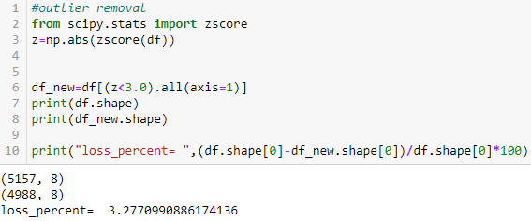
OUTLIER REMOVAL

Slide 13
MODEL TRAINING
Tests were performed on various algorithms like LinearRegression, RandomForestRegressor, KNNRegressor, GradientBoostingRegressor.
The Highest r2_scores obtained from different models are as shown below.
Model | Highest r2_score
KNN Regressor | 0.7067148004690142
RandomForest Regressor | 0.9138416665754213
GradientBoosting Regressor | 0.925243931699905

Slide 14
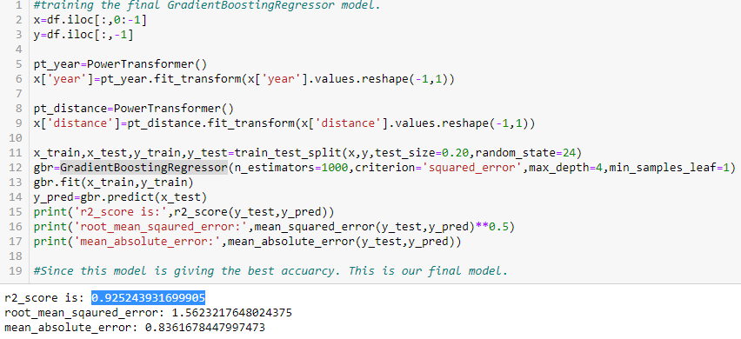
FINAL MODEL
Since GradientBoosting Regressor gave the best results, we are finalising and saving the model.

Slide 15
CONCLUSION
All the columns had low correlation with the target. They gave bad results with LinearRegression like algorithms but gave good results with algorithms like random forest regressor,gradient boosting regressor.
Better results could have been obtained with more number of columns.

Slide 16
Thank you

